Slide 1
AMR systems
* Automatic data reading
* Scheduler for reading
* WEB access
* Reports
* Mailing of Reports
* Many places to Central
* Bidirectional communication to AMDC
* Parametrisation of Meters
* Time synchronisation
Applied Meters, a.s
Ing. Kopaničák

Slide 2
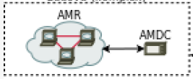
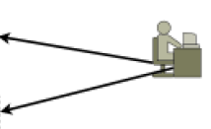
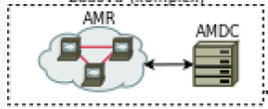
Group 1, 2
AMR systems
AMDC – Data concentrator - Mini PC
* Automatic data reading
* Scheduler for reading
* WEB access
* Low price
* One direction only
Meters in Group
AMDC – Data concentrator – PC
Applied Meters, a.s
Ing. Kopaničák

Slide 3
Group 3
AMR systems
AM Central
* Automatic data reading
* Scheduler for reading
* WEB access
* Low price
* One direction only
Meters in Group
+ Reports
+ Mailing of Reports
+ Many places to Central
+ Bidirectional communication to AMDC
Parametrisation of Meters - III. Q. 2018/
Time synchronisation - III. Q. 2018
Applied Meters, a.s
Ing. Kopaničák

Slide 4
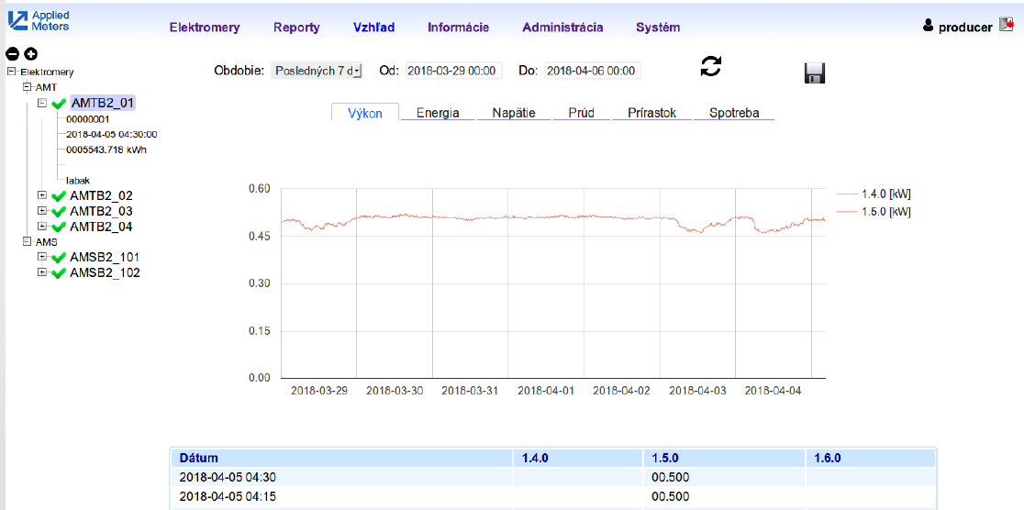
AMDC
AMR systems
Energy
Power 1.5.0
Applied Meters, a.s
Ing. Kopaničák

Slide 5
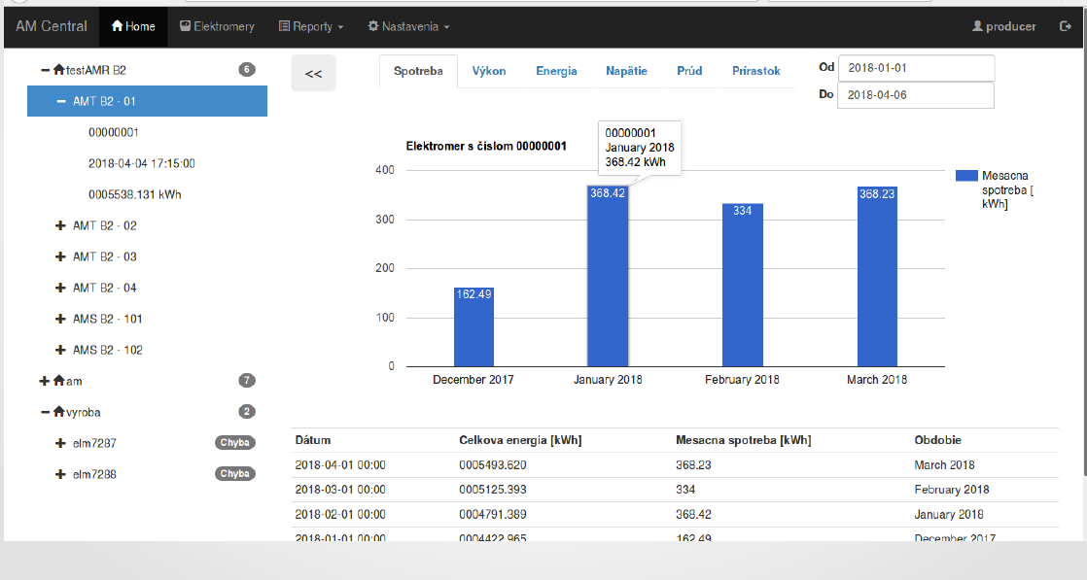
AM Central
AMR systems
Consumption

Slide 6
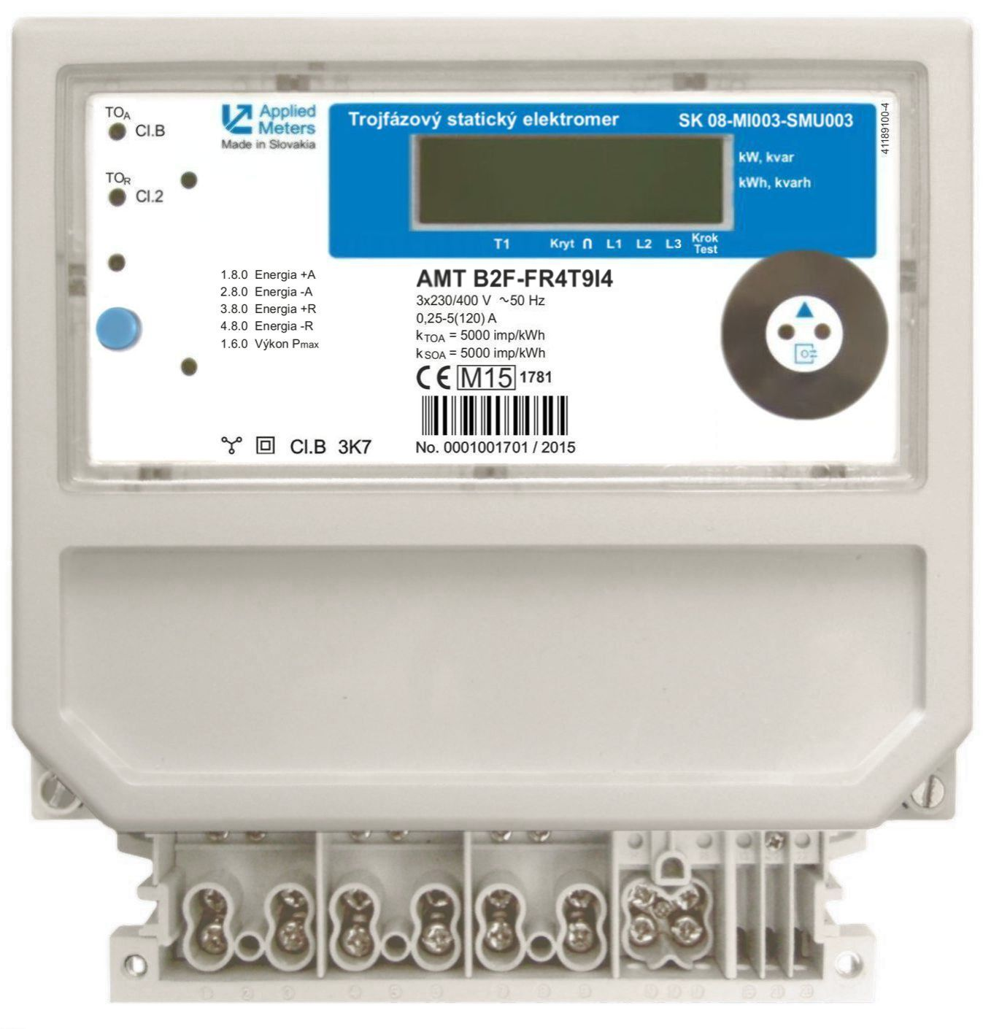
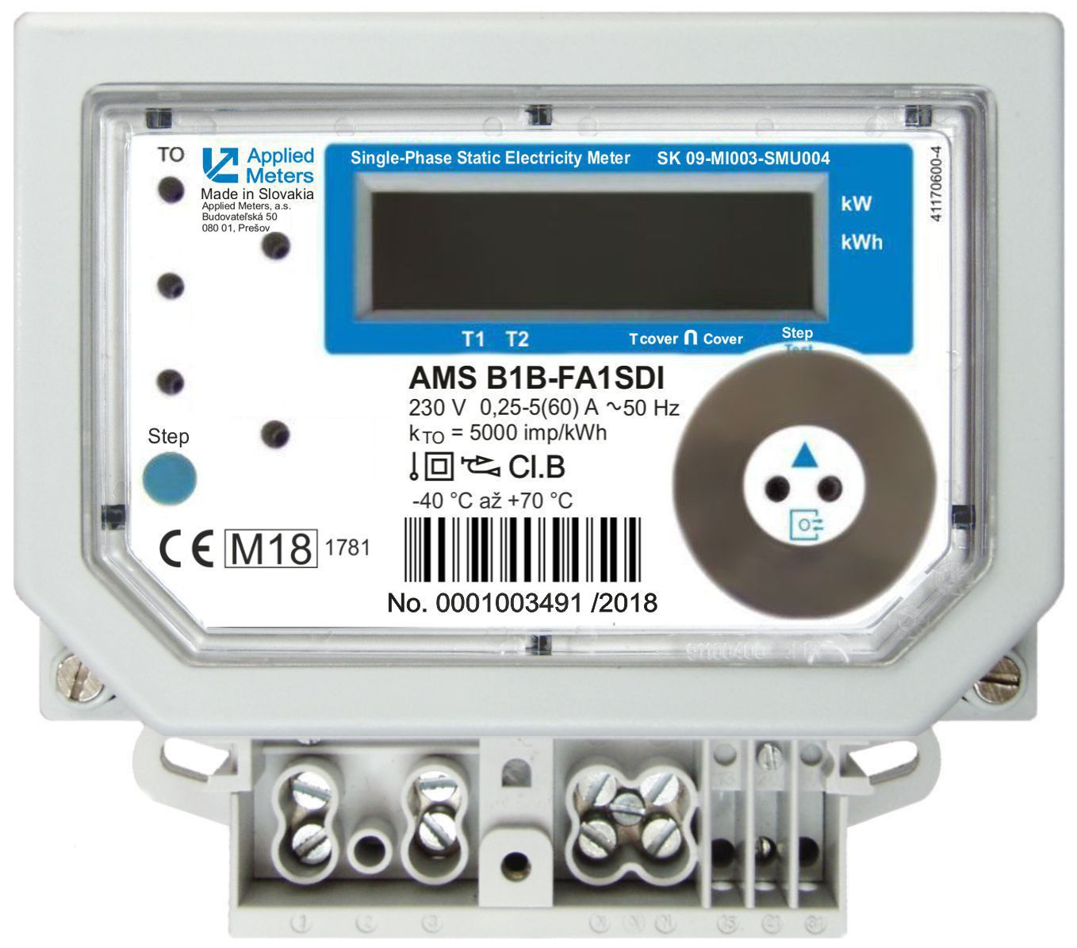
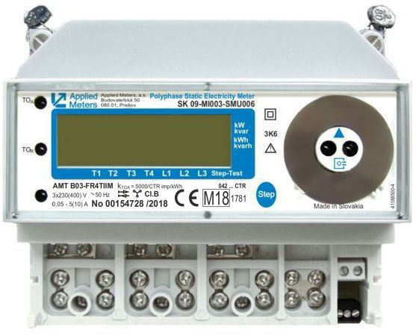
Meters for AMR
AMR systems
AMT B2E FR4TEI4
AMS B2B FR2SDI4
AMT B1C FR4TII4
/AMT B2B FR4TEI4/
RS485
RS485
RS485
Applied Meters, a.s
Ing. Kopaničák

Slide 7
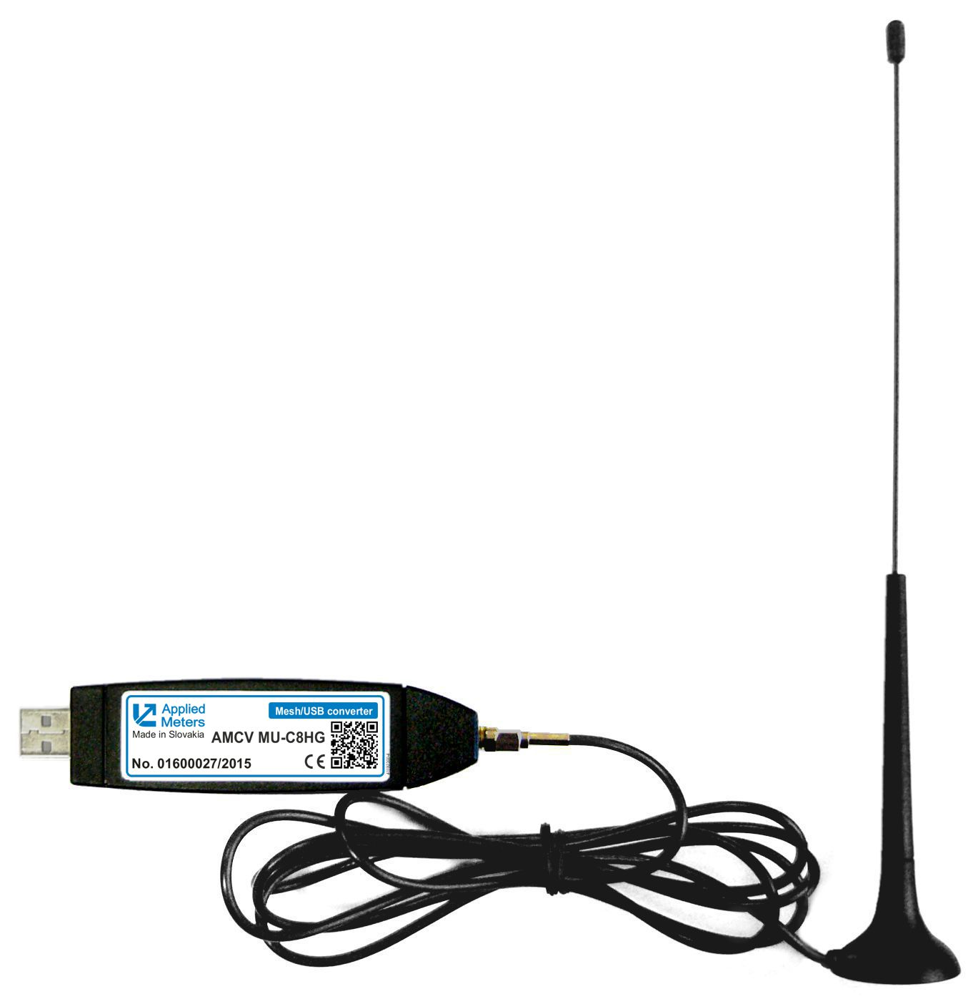
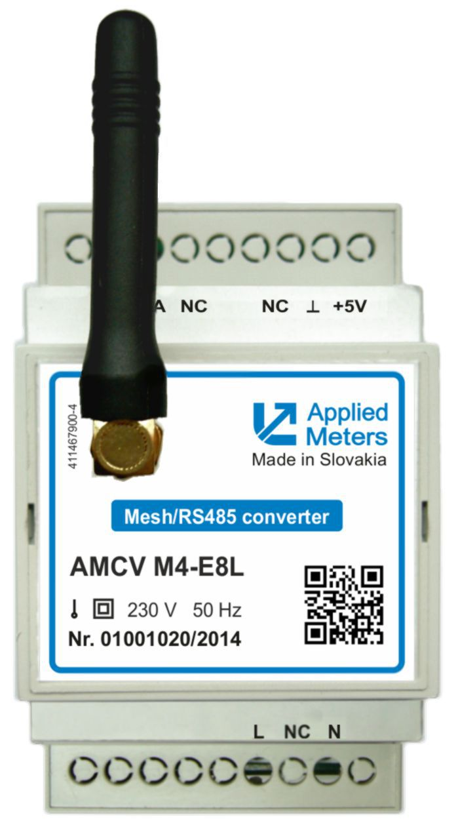
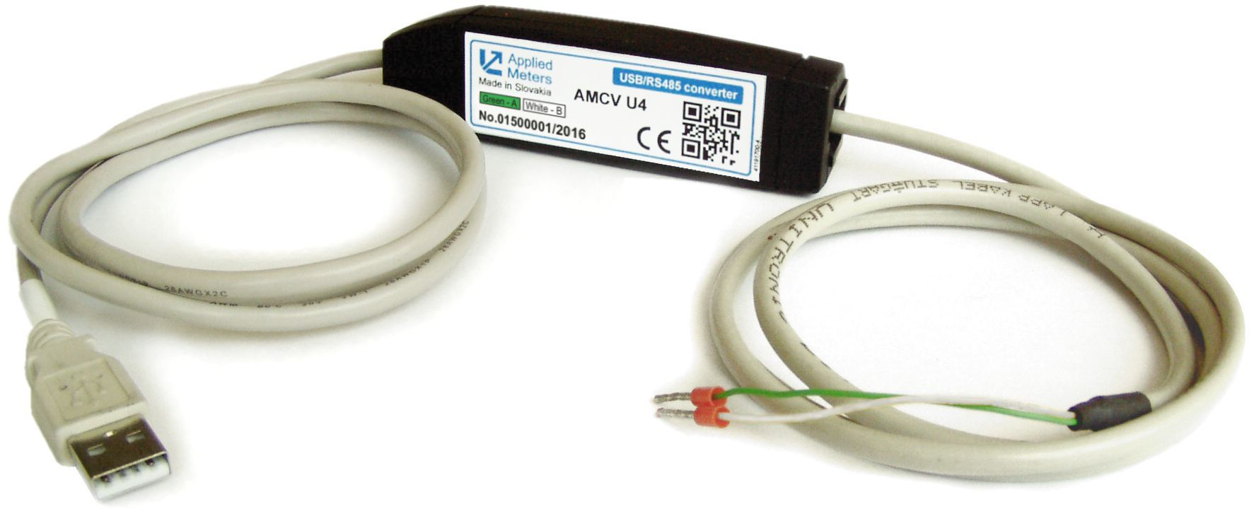
Components for AMR
AMR systems
AMCV MU-x8xG
AMCV M4-x8x
Mesch / USB
Mesch / RS485
RS485
RS485
Applied Meters, a.s
Ing. Kopaničák

Slide 8
Mesh NET
AMR systems
Single Meters
MESCH
USB of:
PC
KCN
Central
RS485
RS485
Group of Meters
RS485
Applied Meters, a.s
Ing. Kopaničák

Slide 9
Mesh NET
AMR systems
Central app.
WEB
Single Meters
Direct WEB
LAN
AMKR
FTP transport
RS485
RS485
SIM card
/LAN
Group of Meters
LAN
AMKR
FTP transport
RS485
Applied Meters, a.s
Ing. Kopaničák

Slide 10
LoRa NET
AMR systems
Thank You for Your Attention!
Applied Meters, a.s
Ing. Kopaničák

